Slide 1
Olympic Medal Winner Analysis

Slide 2
Objective
Comprehensive analysis of the total number of medals awarded across all Olympic events and countries.
Medal distribution among participating countries.
Top 10 countries and sports with highest number of medal won.
Medal distribution based on gender.
Most successful athlete male & female.

Slide 3
Dataset and tools used
The dataset contains historical data since 1896 Olympic games till 2016.
The dataset contains information regarding all the athletes who has taken part in Olympic games but as we are only analyzing medal winners hence I have kept data for medal winners.
I have used pandas for data cleaning and manipulation.
Also I have used python to create SQL engine and SQL queries to answer the same questions which we have answered using pandas.
Finally I have created a dashboard in Power BI to have more intuitive data representation.

Slide 4
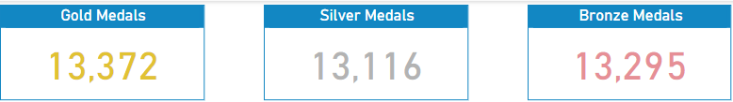
Distribution of Medals.
A total of 39783 medals were awarded in Olympics since 1896 till 2016 in summer and winter seasons.

Slide 5
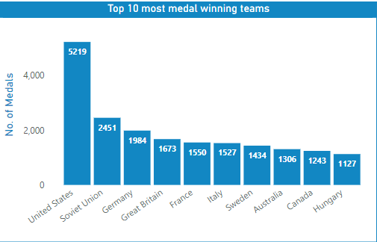
Top 10 countries with most medals.

Slide 6
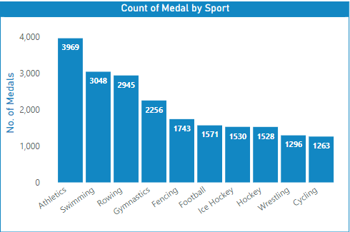
Top 10 sports with most medals.

Slide 7
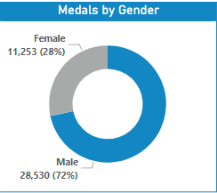
Medal distribution by gender.

Slide 8
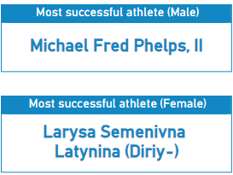
Most successful athlete male and female.

Slide 9
Conclusion
The Olympic data analysis helped us understand how certain countries and sports have performed over the years, and how the competition has changed over time. It also showed how women are taking part more and more in the games. In general, the analysis gave us a clearer view of how medals have been won and how participation has grown worldwide.

